Slide 1
Battery Voltage State Indicator Using 741 ANALOG ELECTRONICS 1 ( LAB) Section : C Course Instructor : BISHWAJIT BANIK PATHIK
Group:4
Member:
Name : Id
1. MD.SHARIARE : 16-31825-1
2.ANWAR,NAJMOL : 16-31042-1
3. HASAN, MD. NAHID : 16-31039-1
4. ISLAM, MD. ASIFUL : 16-31081-1
5. HOSSEN, MD. SADDAM : 16-31420-1

Slide 2
CONTENTS
Introduction
Objective
Circuit Equipment
Project Briefing
Circuit Diagram
Working Methodology
Simulation
Shortcomings
Conclusion

Slide 3
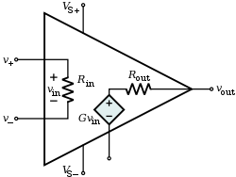
INTRODUCTION
The 741 IC was designed by Dave Fullagar of Fairchild Semiconductor in 1968
The 741 IC is made ideal for use as integrator, summing amplifier, voltage follower and other basic applications.
Features of 741 IC:
Short circuit and overload protection provided.
Low power consumption.
No latch-up problem.

Slide 4
OBJECTIVE:
This circuit uses two op-amps in compare mode , which compare the battery with reference voltage.
The circuit shows three state of battery voltage i.e. charged, discharged and normal using three different color LEDs (Red, Green, Yellow).

Slide 5
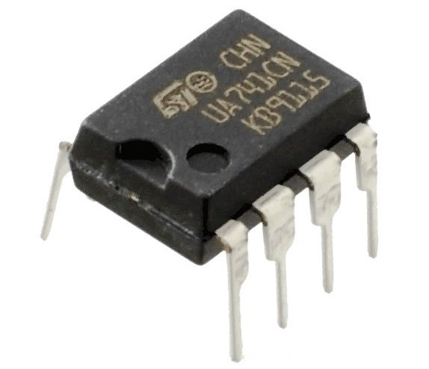
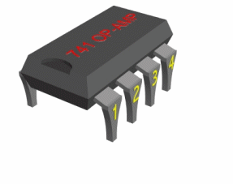
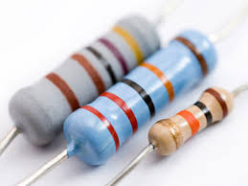
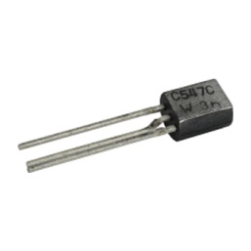
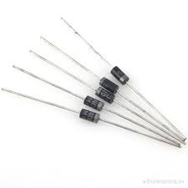

Circuit Components
IC
IC1(741) – 2
Resistor
R1(2.7K) – 1
R3(2.7K) – 1
VR1(22K)
VR2(22K)
Miscellaneous
D1,D2( 1N4148) – 2
LED1-RED
LED2-ORANGE
LED3-GREEN

Slide 6
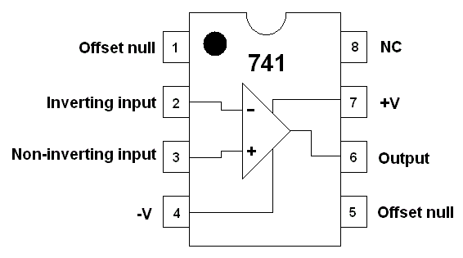
IC PIN DIAGRAM
OP AMP 741

Slide 7
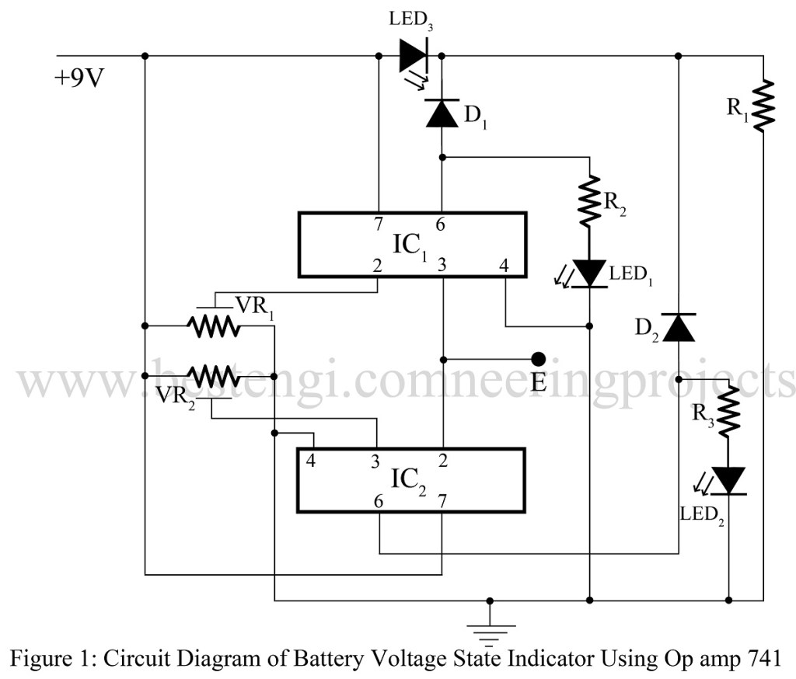
Circuit Diagram

Slide 8
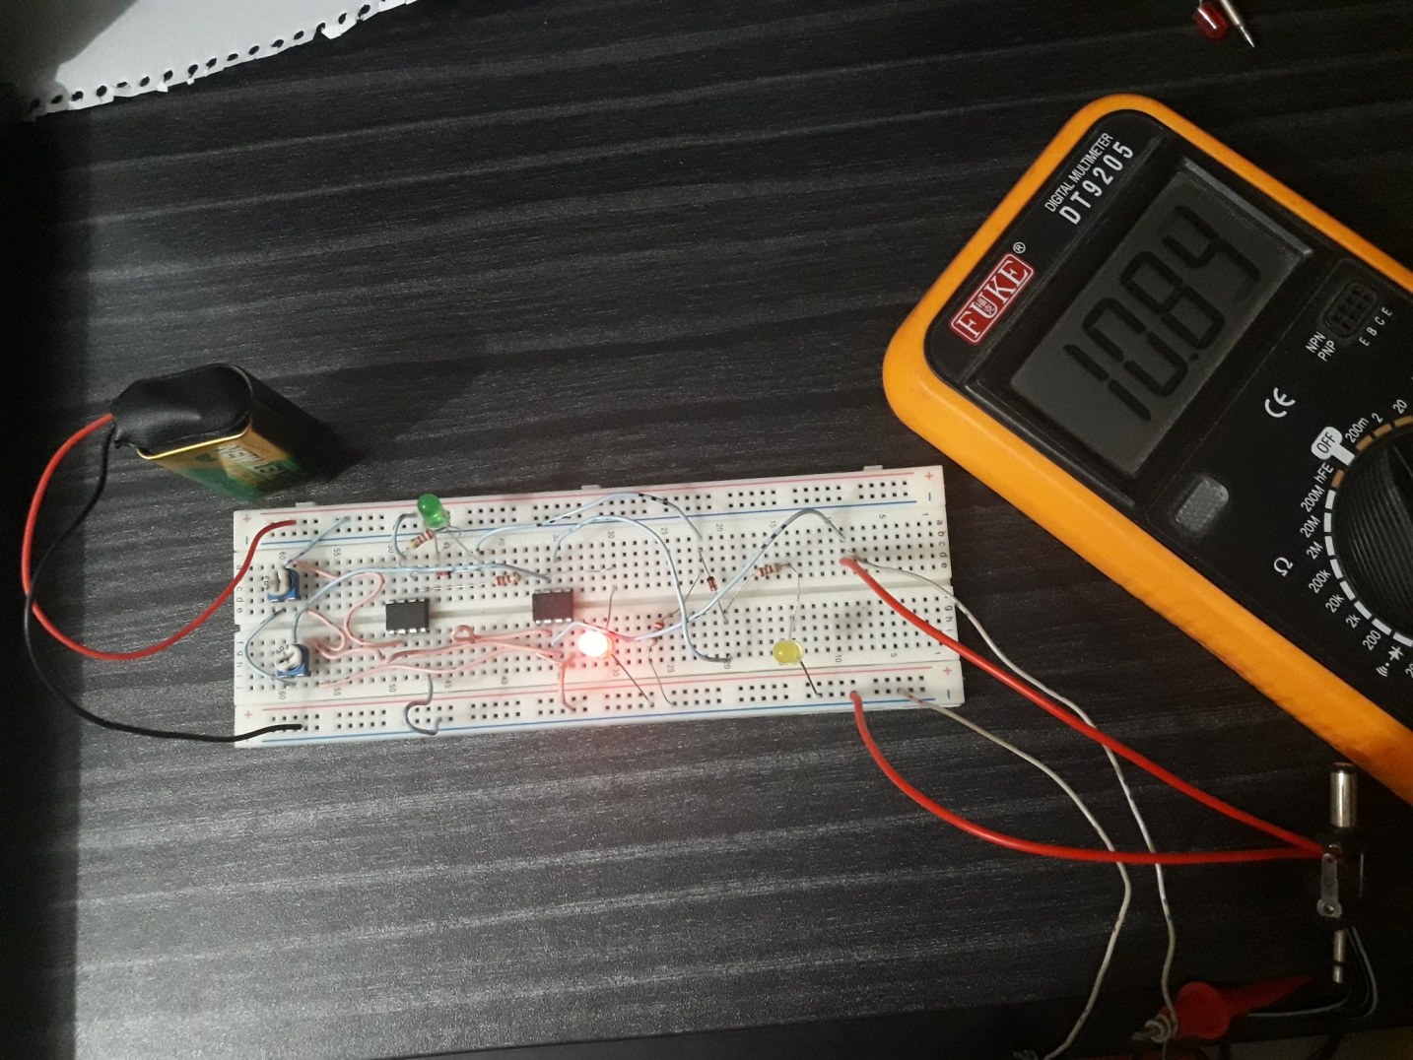
PROJECT FACE:

Slide 9
WORKING MATHODOLOGY
The battery voltage is connected to E (pin 2 of IC₁ and pin 3 of IC₂) as show in circuit diagram, which further compares with reference voltage E₁ and E₂.
If the battery voltage is less then 6V, LED₂ glow, similarly if battery voltage is 6V to 9V LED₃ glow and if the battery voltage is greater than 9V LED₁ glow.
The variable resistors VR₁ and VR₂ is so adjusted that the voltage between pin 2 of IC₁ and earth is 9V and voltage between pin 3 of IC₃ and earth is 6V.

Slide 10
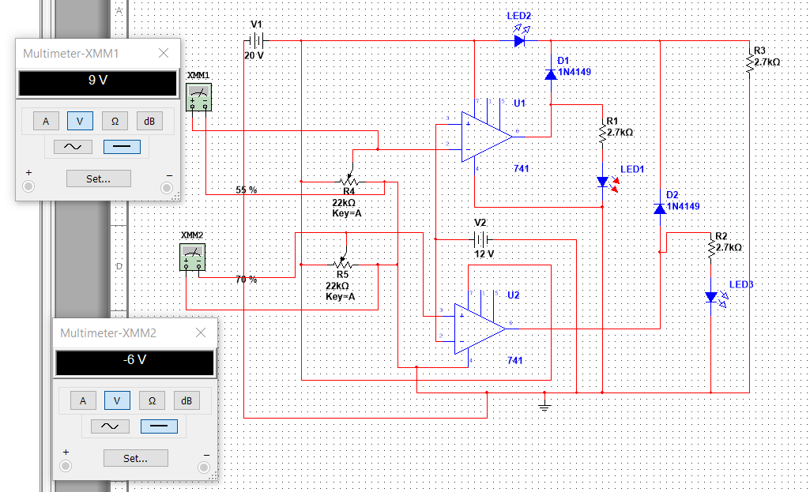
SIMULATION
When voltage is 12V.

Slide 11
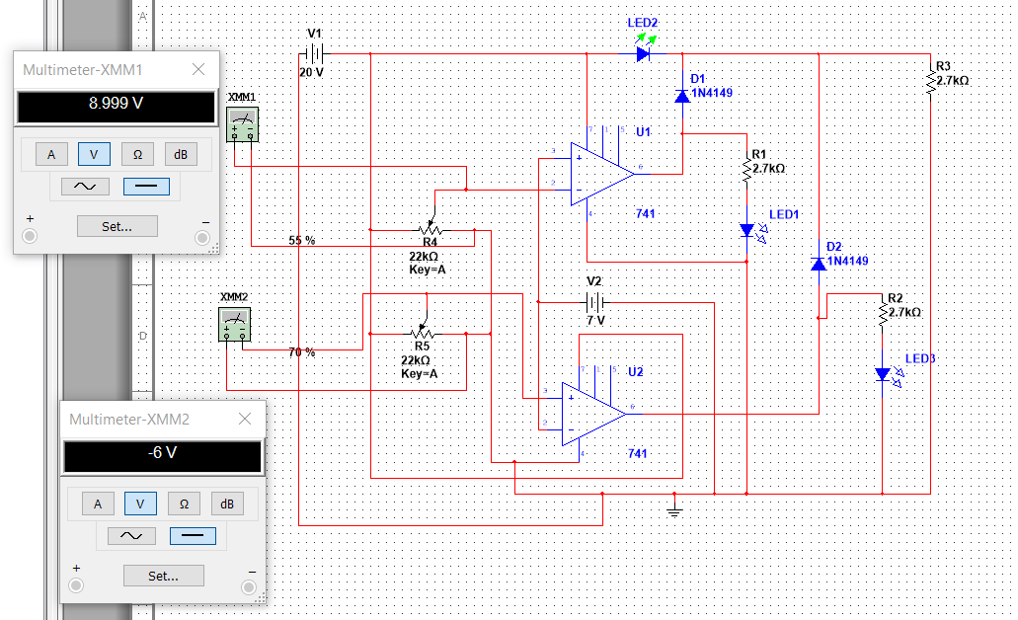
SIMULATION
When voltage is 7V.

Slide 12
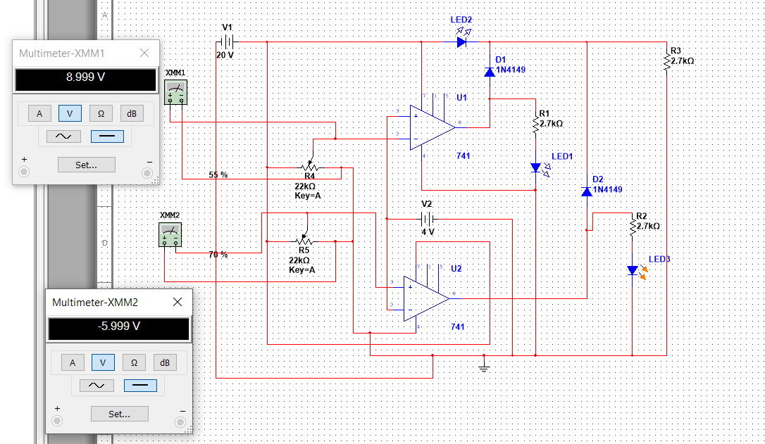
SIMULATION When voltage is 4V.

Slide 13
SHORTCOMINGS
The major limitations of this project are :
Can not indicated larger amount of voltage.
The variable resistor which set the upper and lower state can change accidently..

Slide 14
COST ANALYSIS
LIST OF THE PRODUCTS
COSTS
*BREAD BOARD
*RESISTORS(2.7K,22K)
*JUMPER CABLES
*OP AMP(741)
*BATTERY(9v)
*DIODE
*LED
80TK
30TK(200PCS)
65TK
30TK(2PCS)
40TK
15TK(5PCS)
15TK(5PCS)
TOTAL=245TK

Slide 15
CONCLUSION
Battery voltage state indicator is a small device which we can in our homes to indicate wheather the battery is charged or not.It’s a low cost device which we can build easily.In our homes we use ups,ips,solar panel,all this devices are battery defendant devices Knowing the amount of energy left in a battery compared with the energy it had when it was full gives the user an indication of how much longer a battery will continue to perform before it needs recharging. It is a measure of the short term capability of the battery.So we will be aware of our devices and we can change batteries before the charge runs out and the devices work properly without any barriers.

Slide 16

QUESTION AND ANSWERS

Slide 17
THANK YOU

